Slide 1



Prototype
Here show and discuss your prototype
we've developed for addressing the challenges faced by students at the Faculty of Commerce. Our prototype is designed to provide a practical solution that bridges the gap between academic learning and real-world application. This prototype aims to help students better prepare themselves for the job market while maintaining their academic performance.
You can Put the storyboard and framework design of the product/service
Certainly, we have prepared a storyboard and framework design for the product/service.https://www.canva.com/design/DAFsyDEk46M/IfCRszPA1shPUW8m9C7xsg/view?utm_content=DAFsyDEk46M&utm_campaign=designshare&utm_medium=link&utm_source=publishsharelink

Slide 2
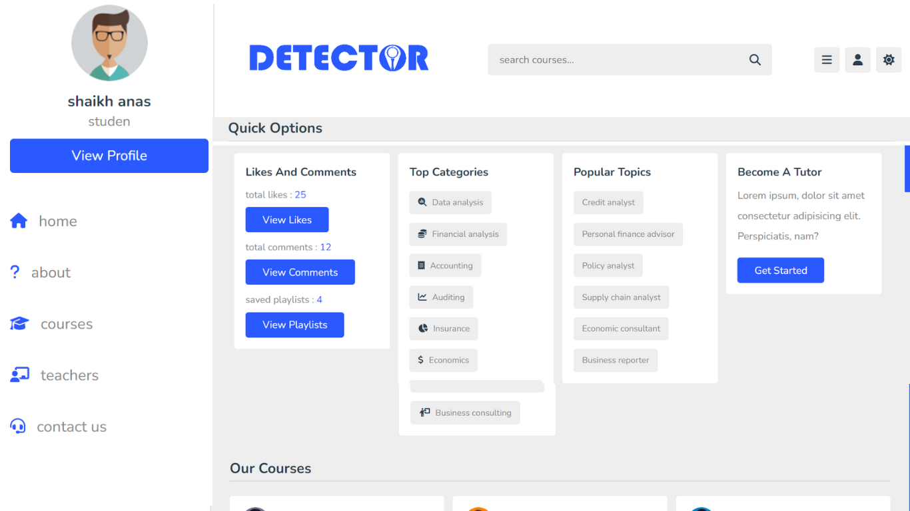
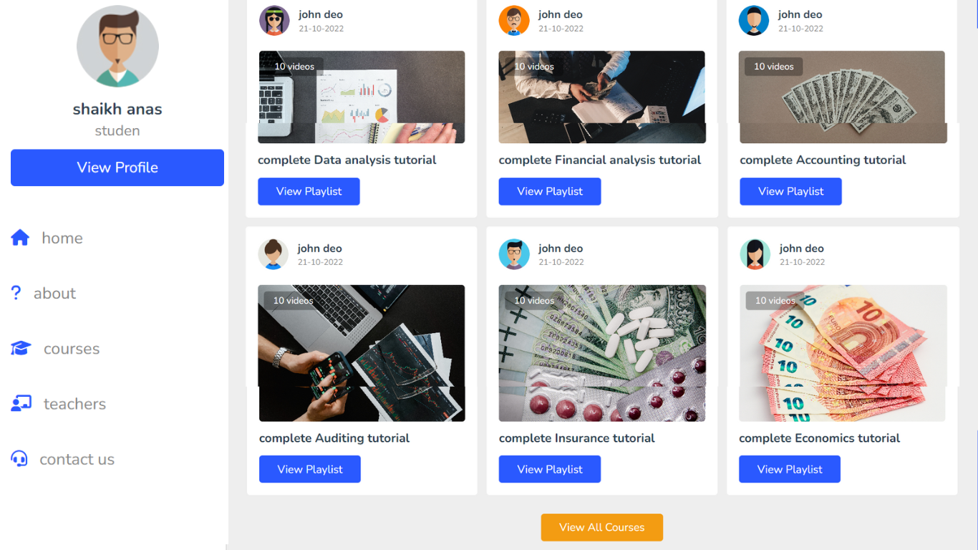
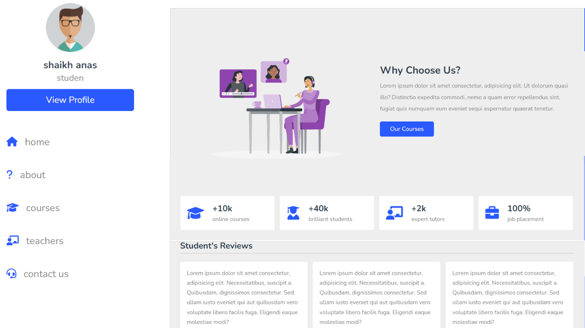
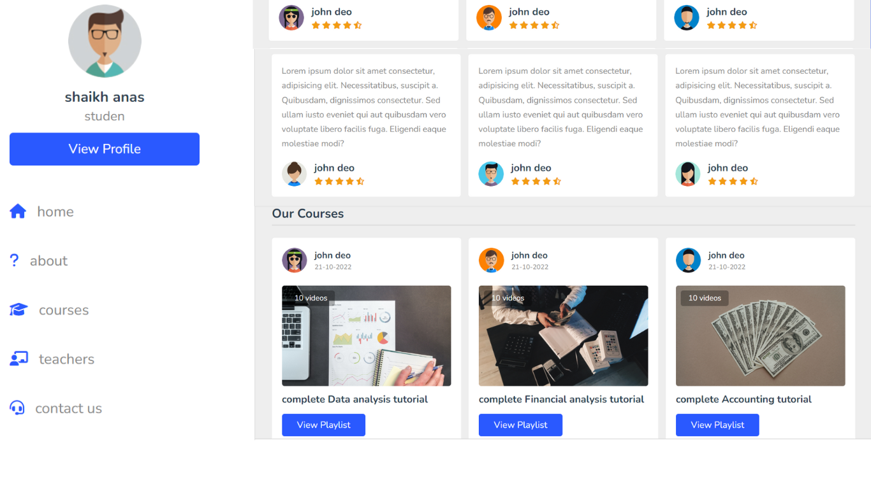
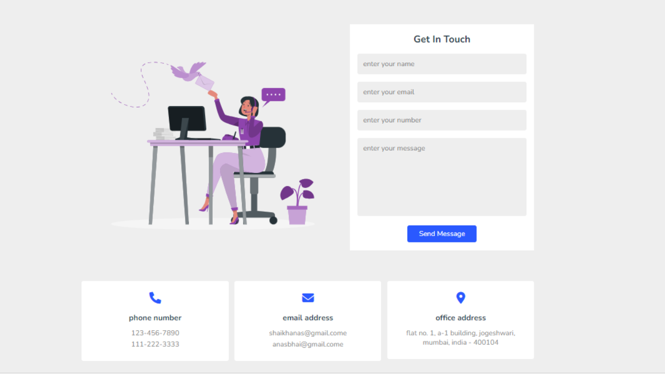
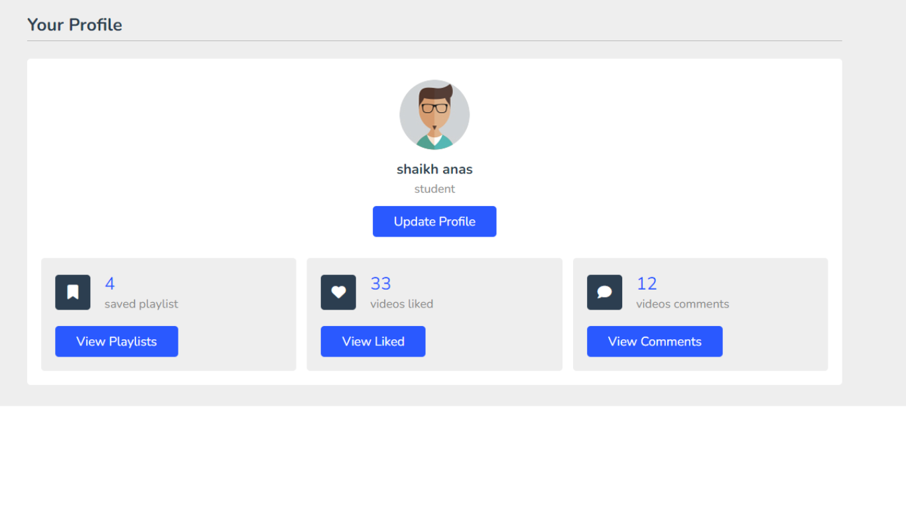
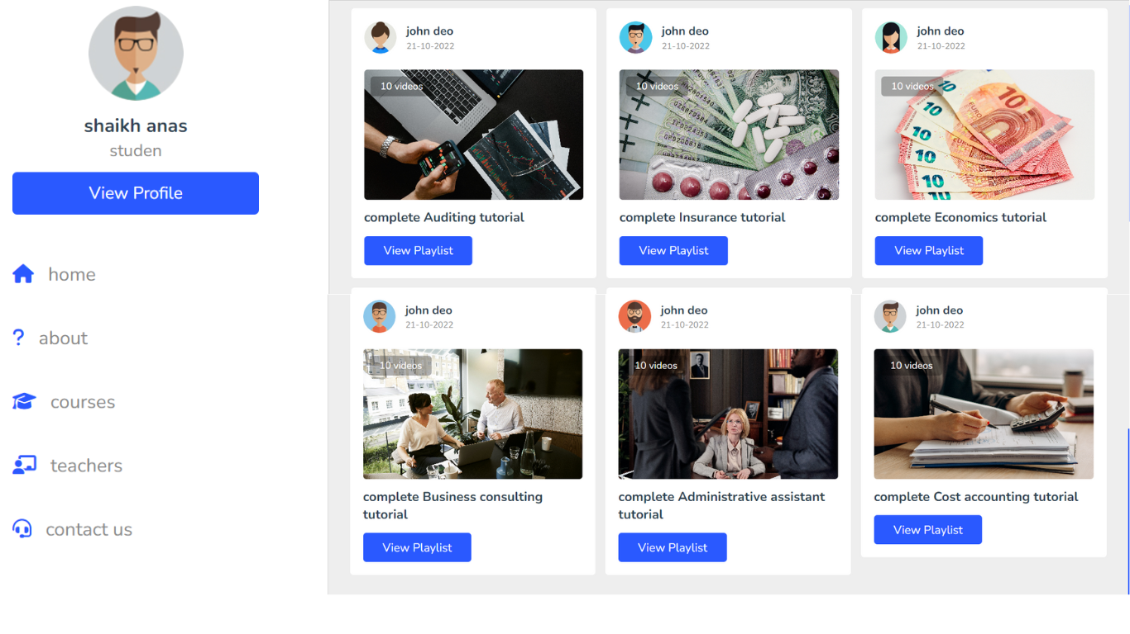
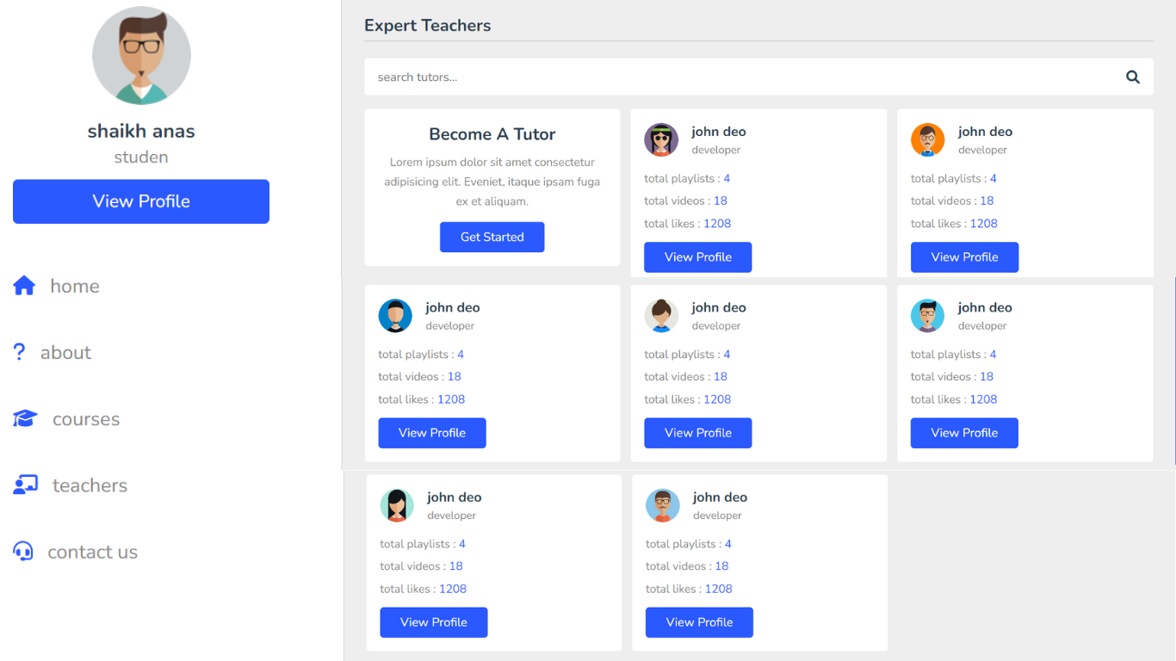
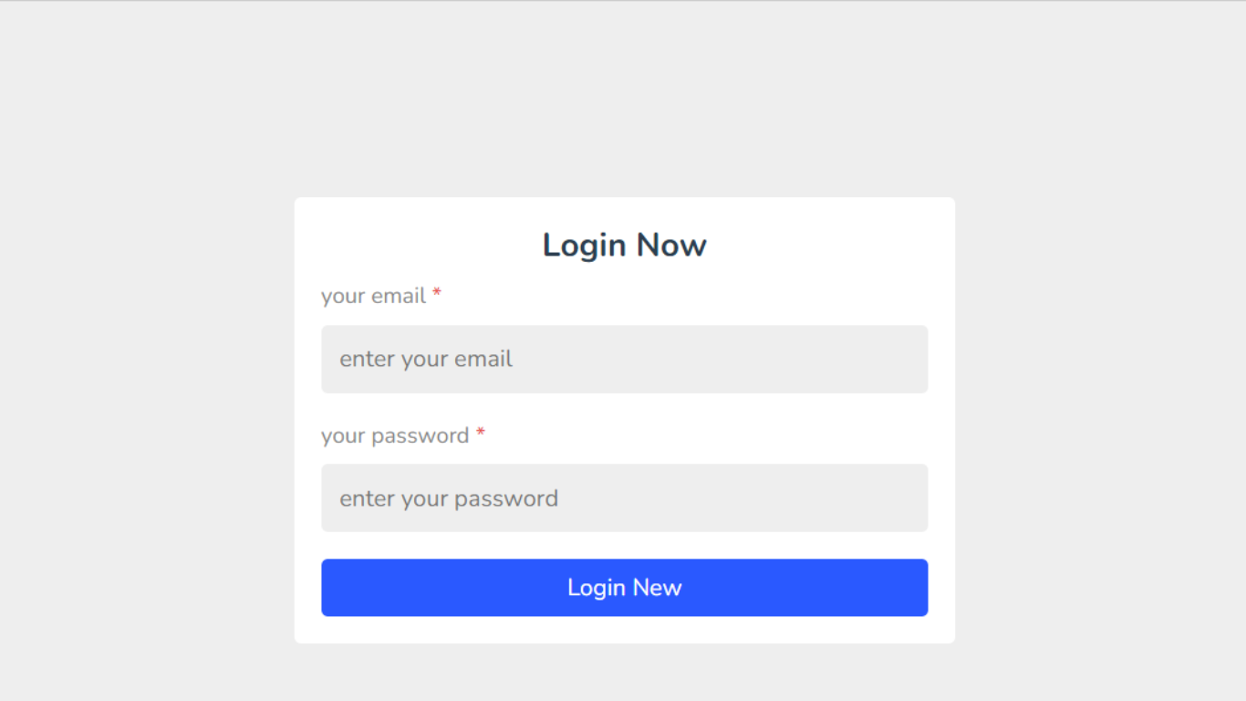
Prototype Photos

